Slide 1



Introduction to Pattern Recognition
MCSE 666:Pattern and Speech Recognition
Dr. Md. Aminul Haque Akhand Dept. of CSE, SUB

Slide 2
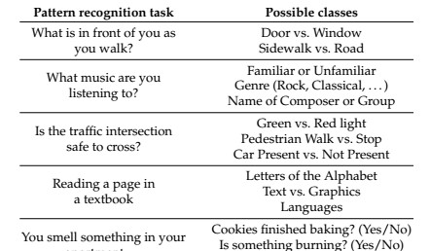
What Is Pattern Recognition?
2
Pattern recognition (PR) is a process by which some input is measured, analyzed, and then classified as belonging to one of a set of classes
Process of PR and classification is a continual, never ending
aspect of every-day human existence:

Slide 3
What Is Pattern Recognition? Cont.
3
PR as a human experience refers to a perceptual process: some form of sensory input is sensed, analyzed, and recognized (classified), either subconsciously (by instinct) or consciously (based on previous experience).
Patterns may be presented in any sensory modality: vision, hearing, touch, taste, or smell.
PR as a technical discipline: a process in which an input object is measured, analyzed, and classified by a machine as being more or less similar to some class in a set of classes.

Slide 4
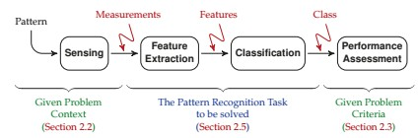
Pattern Recognition Framework
4
The goal of PR is to provide a machine with a kind of perceptual capability to automatically extract useful information from measured data.

Slide 5



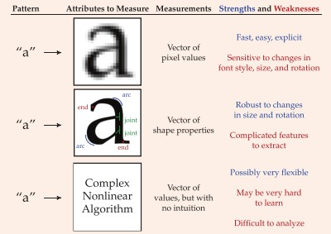
5
PR Illustration with Example
Pattern Recognition of Text

Slide 6

PR Illustration with Example
6
Pattern Recognition of the Mind
It deons’t mettar in waht oerdr the lrttees in a wrod are, as lnog as the frist and lsat ltteres rmeain in the rgiht pacle.
The retina in the eye is densely packed with light-sensitive cells, so that it may be tempting to think
Our brain effectively sees and perceives the world as a great many pixels.
There are many simple mind tricks or optical illusions

Slide 7
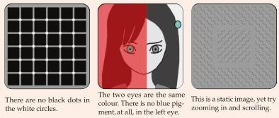
PR Illustration with Example
7
Pattern Recognition of the Mind
The eye is not just sending pixellated images to the brain.
There is a great deal of feature extraction taking place, much already in the retina
It is very helpful in running through a forest, but perhaps not so useful in staring at deliberately manipulated images on a page.

Slide 8

Features from Patterns
8
The word “pattern” may bring to mind texture, fabric, or shape.
In the context of pattern recognition, the notion of pattern is far more broad, and can apply to any thing that can be distinguished from another thing.
Identity view point: infer the unknown identity of an object
Type of wildflower, type of songbird, or the name of the person facing a camera — each of these has a certain identity to determine from measurements.
A pattern is assumed to have certain properties or
attributes which distinguishes it from other patterns.

Slide 9
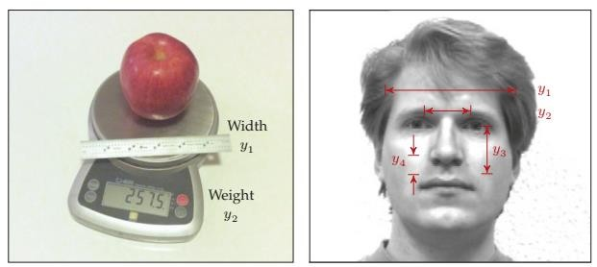
Features from Patterns (Cont.)
9
One or more measurements are taken of a pattern
Size / weight of a piece
Various dimensions from face
Does all measurements from patterns important to distinguish?

Slide 10
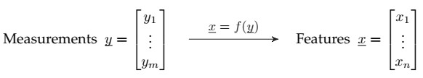
Features from Patterns (Cont.)
10
The selection of appropriate measurements is an essential
Measurements may cost money and/or time, and
Poor measurements lead to poor performance of the resulting classifier.
The process of transforming measurements into features facilitate classification, normally in one or both of the following ways:
By reducing the dimensionality of the problem: n < m
By creating
features in which patterns are more clearly
distinguished.

Slide 11
Features from Patterns (Cont.)
11
The feature extraction function f() can focus the information from x, or it can remove irrelevant information from x, but f() never adds information.
Data Processing Theorem: x can never have more
information than was present in y.
An effective feature extraction function f() can make the PR problem easier,
However, in principle, the best possible classifier based on the measurements y should perform at least as well as the best possible classifier based on the features x.

Slide 12


Features from Patterns (Cont.)
12
Features may be intuitive or they may be quite abstract.
Consider, the measurements of an electric motor:
Power as Feature: Understandable
Uninterpretable feature do not
make any physical sense,
But perhaps be effective as a feature for classification.

Slide 13
Classes and Classification
13
The whole purpose of PR or classification consists of
assigning an object to a class.
A class is a particular pattern, or possibly a group of patterns which are similar or equivalent in some sense.
In a given problem, the set of classes C is defined as
C = {C₁; C₂; -; -; -; -; C_{K} };
Have to choose one class from K different classes.
Members of a class share some common properties or attributes
In PR problems the class set C is predefined and has been specified as part of the problem to be solved.

Slide 14
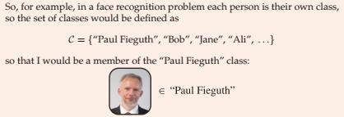

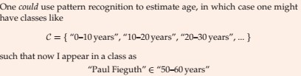
Classes and Classification
14

Slide 15
Classes and Classification
15
Way of Describing Classes
Via Prototype Idealized representation or notion of the “essence” of the class. Pros: each class is unambiguously defined, Cons: no scope for variability.
Via Parameterized Shape: A generalization of the prototype; the class has a known shape (e.g., rectangular or elliptical), the shape is described in some number of parameters (e.g., ellipse centre, rotation, and axis lengths). Pros. more flexible than that of a single prototype, Cons: still requires the type of shape to be assumed or known.
Via Statistical Distribution: Some description of the likelihood or probability of a class member having a particular set of measurements or features. Pros.: very comprehensive, Cons: There will be circumstances when the statistics are not known and may be difficult to infer.
Via Samples: A set of given samples (many apples, or tigers, or bicycles) directly characterizes the class. Pros: Highly convenient, since nothing further needs to be done to describe the class Cons: Storage and computational challenges, since all of the data need to be saved.

Slide 16
Classes and Classification
16
Variability in a Class
Patterns do not need to be identical to belong to the same class: not all pictures of a person the same, or of tigers, or of apples.
There are at least two sources of variability present in the measurements associated with a single class:
The inherent variability within a class: Every class will consist of members which differ in some way. The degree and nature of the inherent variability will depend greatly on the class definition.
“Fruit” class contains all manners of variability in colour, size, and shape; “Apple” class is much more specific, but apples do come in different colours and patterning; the “Granny Smith Apple” class is even more specific, but still will have apples of different sizes or with more or fewer blemishes.
Noise or random variations in measurement: Every measurement
involves some sort of physical process which will be subject to error, such as thermal noise in electronics, or quantization noise in converting an analogue signal to a digital representation.

Slide 17
Open Discussion on Course Conduction
17

